Slide 1
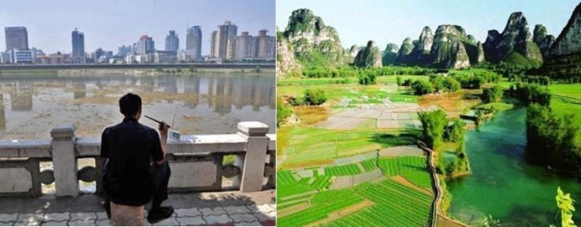
Environment Quality and Economic growth
Saket Pande

Slide 2

Towards general equilibrium
p
producer
consumer
w, r
Socio-economy

Slide 3
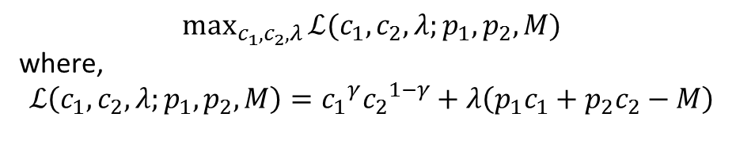
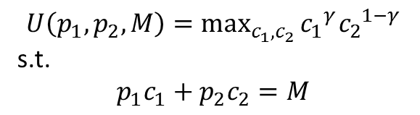
Utility maximization
$$U\left(p_{1},p_{2},M\right)=\max_{c_{1},c_{2}}{{c_{1}}^{γ}{c_{2}}^{1−γ}}$$
s.t.
$$p_{1}c_{1}+p_{2}c_{2}=M$$
$$\max_{c_{1},c_{2},λ}{ℒ(c_{1},c_{2},λ;p_{1},p_{2},M)}$$
where,
$$ℒ\left(c_{1},c_{2},λ;p_{1},p_{2},M\right)={c_{1}}^{γ}{c_{2}}^{1−γ}+λ\left(p_{1}c_{1}+p_{2}c_{2}−M\right)$$

Slide 4
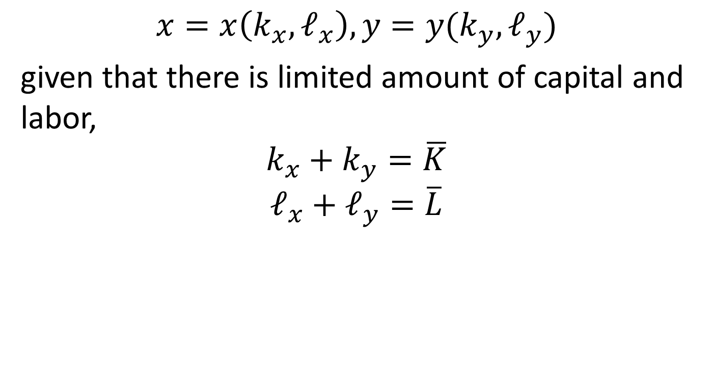
Production of two goods
$$x=x\left(k_{x},ℓ_{x}\right), y=y(k_{y},ℓ_{y})$$
given that there is limited amount of capital and labor,
$$k_{x}+k_{y}=\overline{K}$$
$$ℓ_{x}+ℓ_{y}=\overline{L}$$

Slide 5
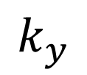
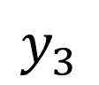
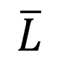
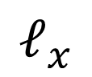
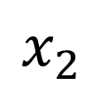
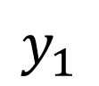
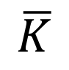
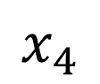
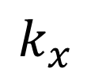
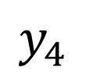
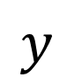
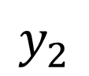
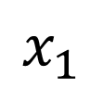
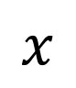
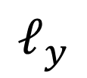
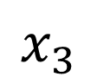
Production Edgeworth box and the efficient production set
$$ℓ_{y}$$
$$y$$
$$x_{4}$$
$$x_{3}$$
$$x_{2}$$
Efficient production set
$$\overline{K}$$
$$k_{x}$$
$$x_{1}$$
$$y_{1}$$
Slope = -w/r = implicit price ratio of labor to capital
$$k_{y}$$
(Capital)
$$y_{2}$$
$$y_{3}$$
$$y_{4}$$
$$x$$
$$ℓ_{x}$$
$$\overline{L}$$
(Labor)

Slide 6
Efficient allocation of inputs and efficient production set
Efficient allocation of inputs: an allocation of inputs to the production of outputs such that it is not possible to produce more of one good without producing less of another
Efficient production set: set of efficient allocation of inputs for all possible level of outputs

Slide 7
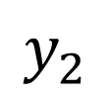
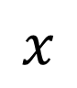
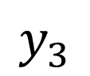
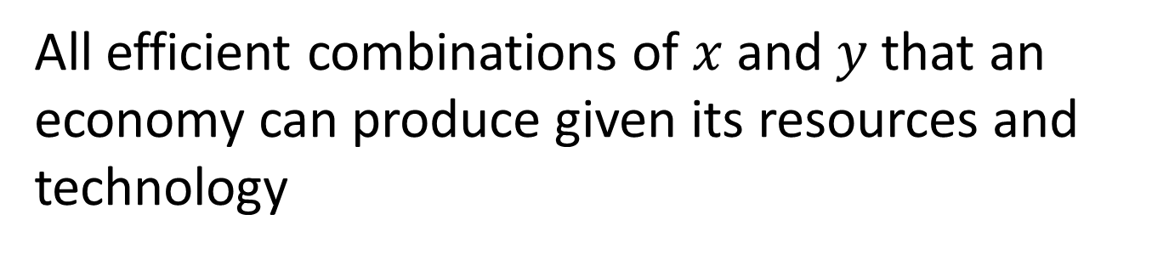
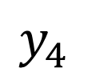
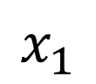
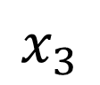
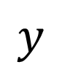
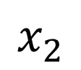
Production possibility frontier
All efficient combinations of $x$ and $y$ that an economy can produce given its resources and technology
$$y$$
Production combinations corresponding to efficient allocation of inputs along the efficient production set
$$y_{4}$$
$$y_{3}$$
$$y_{2}$$
$$x_{1}$$
$$x_{2}$$
$$x_{3}$$
$$x$$

Slide 8
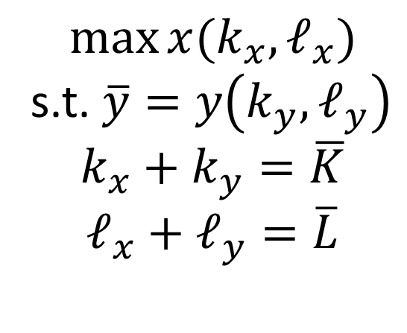
How to obtain production possibility frontier mathematically?
Problem formulation: maximize production of one good subject to constraints that the production of the second good is at a certain level and availability of inputs is limited (balance)
$$\max{x(k_{x},ℓ_{x})}$$
s.t. $\overline{y}=y\left(k_{y},ℓ_{y}\right)$
$$k_{x}+k_{y}=\overline{K}$$
$$ℓ_{x}+ℓ_{y}=\overline{L}$$

Slide 9
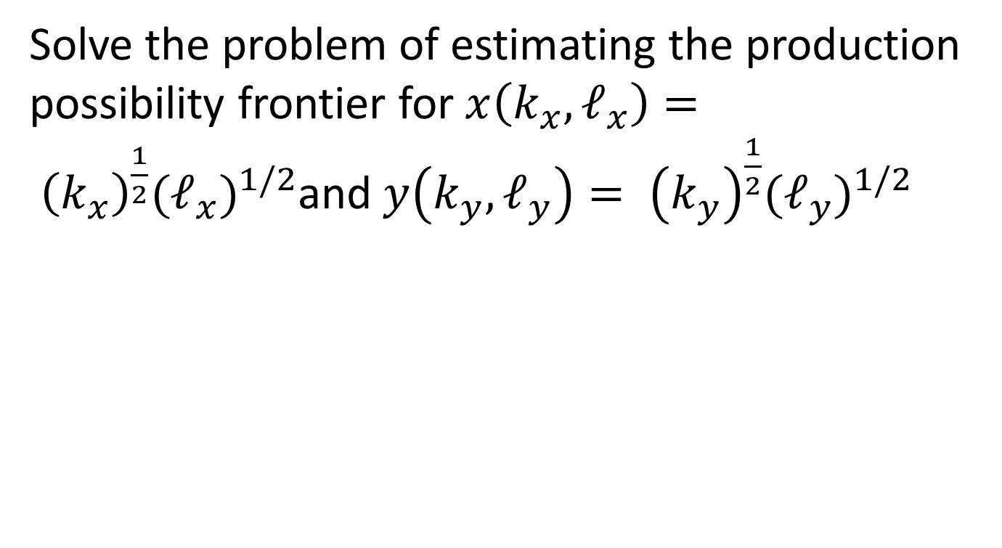
Production possibility frontier: An example
Solve the problem of estimating the production possibility frontier for $x\left(k_{x},ℓ_{x}\right)= {\left(k_{x}\right)}^{\frac{1}{2}}{(ℓ_{x})}^{1/2}$and $y\left(k_{y},ℓ_{y}\right)= {\left(k_{y}\right)}^{\frac{1}{2}}{(ℓ_{y})}^{1/2}$

Slide 10
General Equilibrium 1.0: Robinson Crusoe economy
Robinson is stuck on an island (a closed society). He derives his wellbeing from coconuts and fish (society derives its utility from two goods). However, he himself has to spend his labor and physical capital to gather coconut and hunt fish (society has to produce the goods that it consumes based on limited availability of capital, labor and technology). What level of well being can he achieve ? (what level of development can society achieve?)

Slide 11
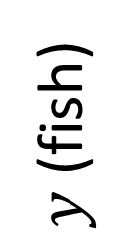
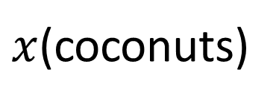
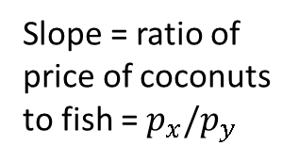
General equilibrium 1.0: Emergence of prices, efficient production and utility maximization
Production possibility frontier F(x,y)=0
U(x,y): derived wellbeing
$y$(fish)
Slope = ratio of price of coconuts to fish = $p_{x}/p_{y}$
$x$(coconuts)

Slide 12

Where do the prices $w,r and p$ come from?
economy at equilibrium
Prices are such that respective markets (or supply balances the demand for beer and bitterballen) clear
Consumers and producers agree on the price and quantity of commodities
Consumers maximize their utilities at those prices and quantities
Producers maximize their profits at those prices and quantities

Slide 13
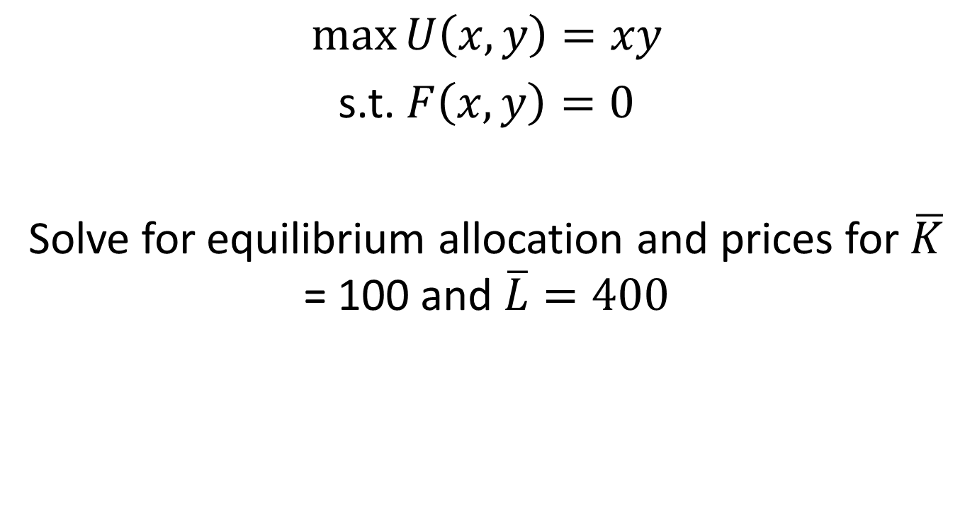
General Equilibrium 1.0: Problem formulation
$$\max{U\left(x,y\right)=xy}$$
s.t. $F\left(x,y\right)=0$
Solve for equilibrium allocation and prices for $\overline{K}$ = 100 and $\overline{L}=400$

Slide 14
End of hour 1

Slide 15
What do we need to explain this pattern of environment and growth?
How can we build low order models of economies or societies realistically?
Do we need models that determine how environment and economic growth shape each other as societies evolve over generations?
where scope for investment in environment and economic growth is possible?

Slide 16
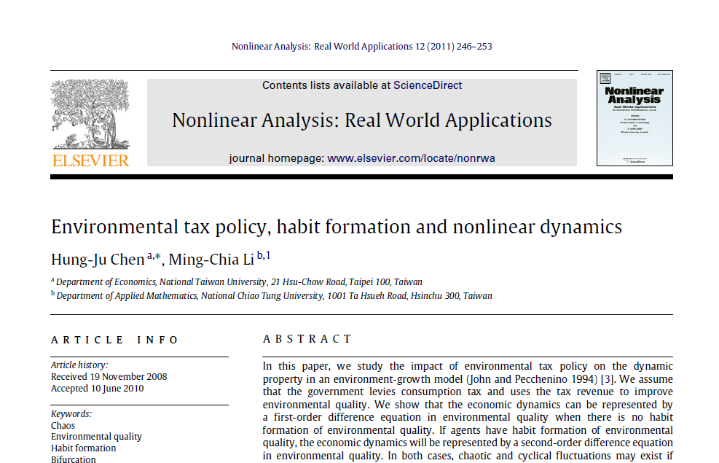
John-Pecchenino model & its variant

Slide 17
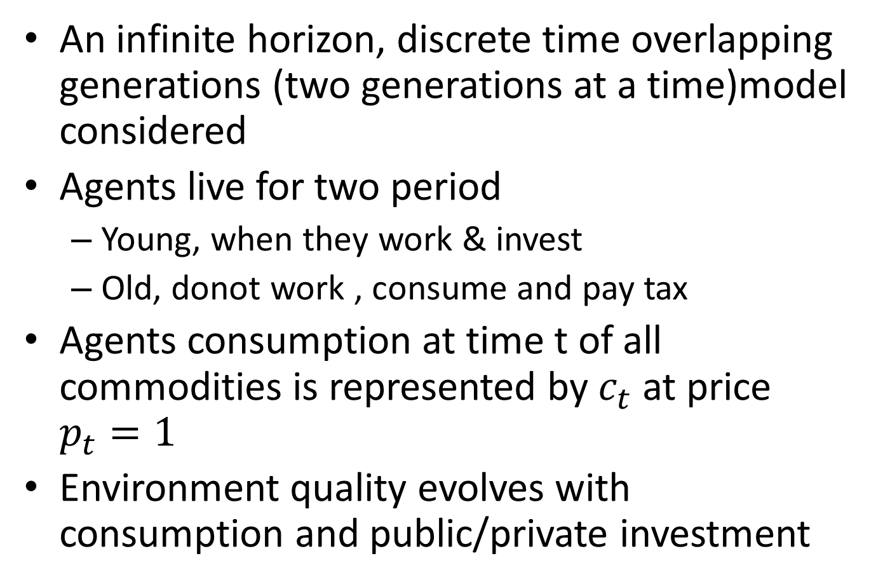
Environment quality and Economic growth
An infinite horizon, discrete time overlapping generations (two generations at a time)model considered
Agents live for two period
Young, when they work & invest
Old, donot work , consume and pay tax
Agents consumption at time t of all commodities is represented by $c_{t}$ at price $p_{t}=1$
Environment quality evolves with consumption and public/private investment

Slide 18

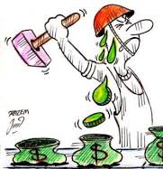
The overlapping generations model: constructing a society
Time t-1
Time t
Time t+1
Time t+2
A generation
At one time, old of one generation overlaps with the young of the other; defining a society

Slide 19

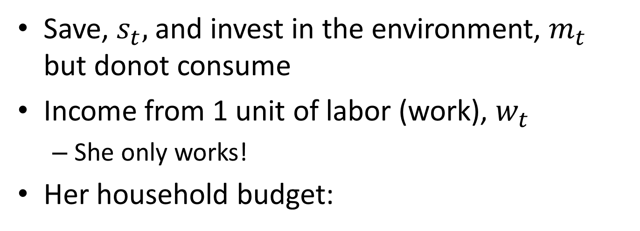
Young agents
Save, $s_{t},$ and invest in the environment, $m_{t}$ but donot consume
Income from 1 unit of labor (work), $w_{t}$
She only works!
Her household budget:
$$s_{t}+m_{t}=w_{t}$$

Slide 20
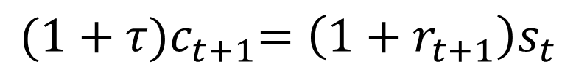
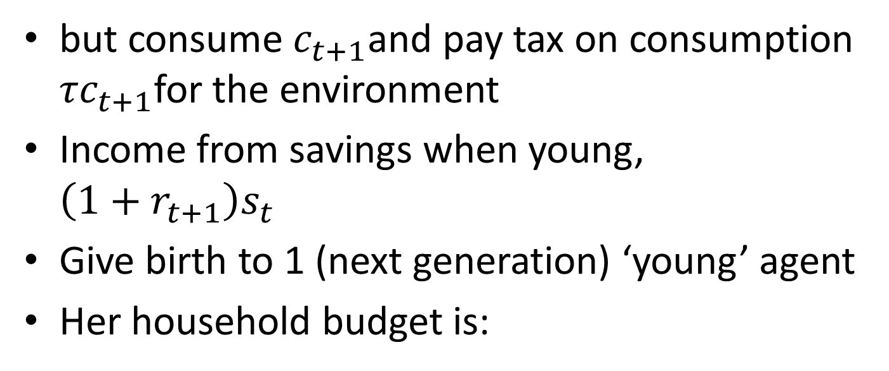
Old agents
but consume $c_{t+1}$and pay tax on consumption ${τc}_{t+1}$for the environment
Income from savings when young, $\left(1+r_{t+1}\right)s_{t}$
Give birth to 1 (next generation) ‘young’ agent
Her household budget is:
$${(1+τ)c}_{t+1}=\left(1+r_{t+1}\right)s_{t}$$

Slide 21
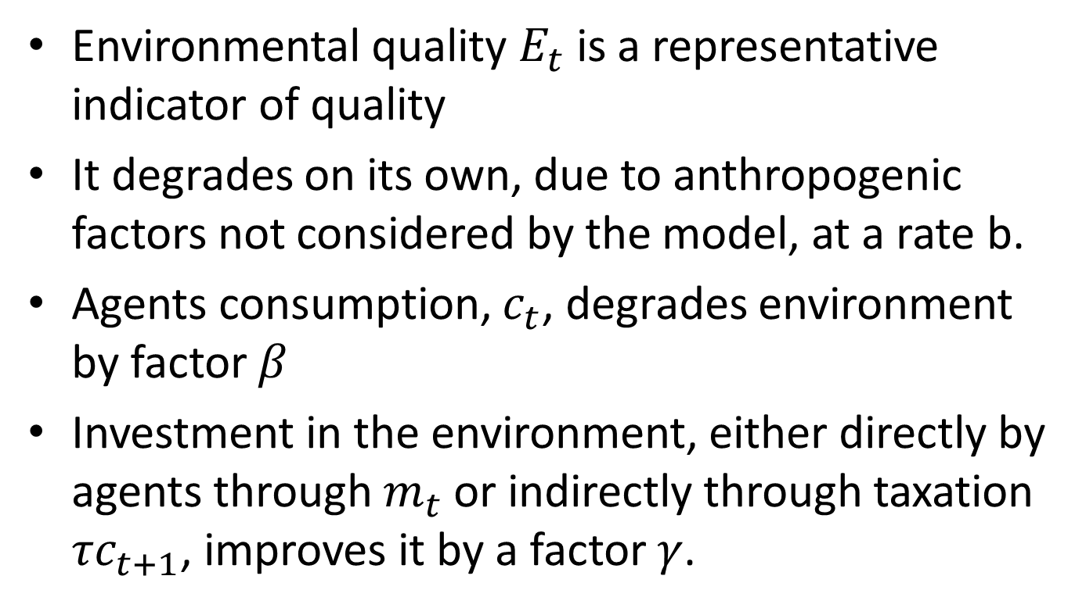
Environmental quality
Environmental quality $E_{t}$ is a representative indicator of quality
It degrades on its own, due to anthropogenic factors not considered by the model, at a rate b.
Agents consumption, $c_{t}$, degrades environment by factor $β$
Investment in the environment, either directly by agents through $m_{t}$ or indirectly through taxation ${τc}_{t+1}$, improves it by a factor $γ$.

Slide 22
Evolution of environmental quality
$$E_{t+1}={(1−b)E}_{t}−βc_{t}+γ(m_{t}+{τc}_{t})$$

Slide 23
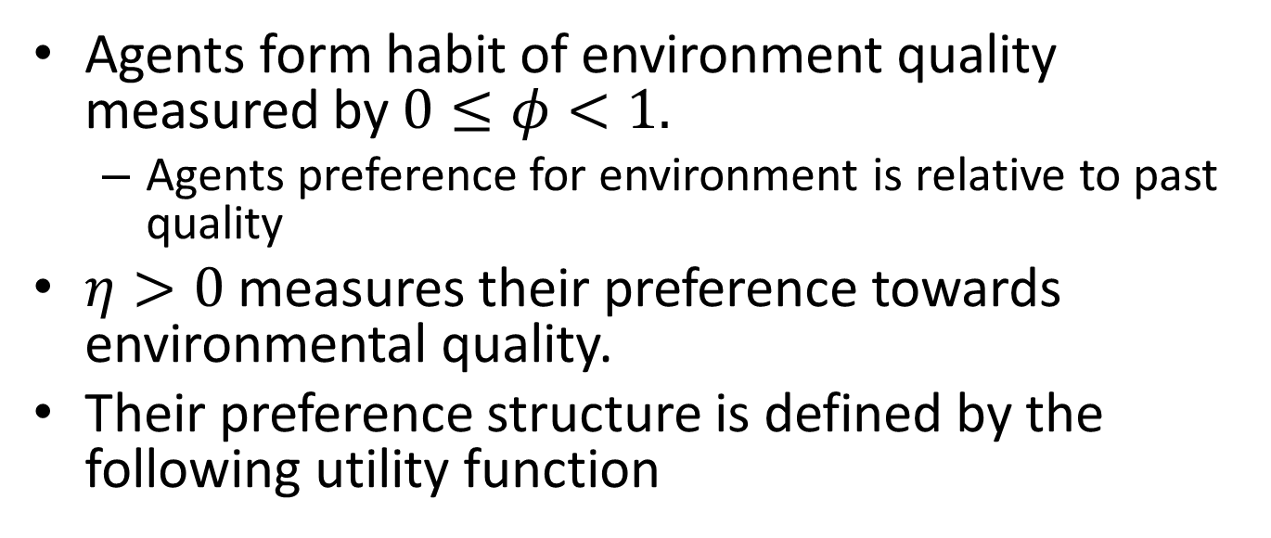
How do agents prefer consumption to the environment?
Agents form habit of environment quality measured by $0≤φ<1.$
Agents preference for environment is relative to past quality
$η>0$ measures their preference towards environmental quality.
Their preference structure is defined by the following utility function
$$U\left(c_{t+1},E_{t+1},E_{t}\right)=logc_{t+1}+ηlog⁡(E_{t+1}−φE_{t})$$

Slide 24
End of hour 2

Slide 25
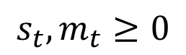
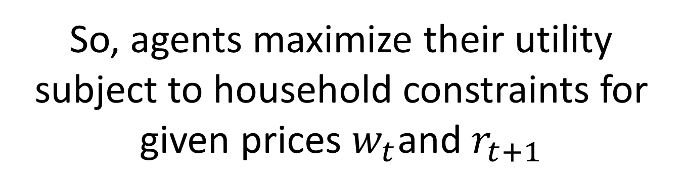
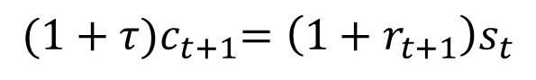

So, agents maximize their utility subject to household constraints for given prices $w_{t}$and $r_{t+1}$
Max $U\left(c_{t+1},E_{t+1},E_{t}\right)=logc_{t+1}+ηlog⁡(E_{t+1}−φE_{t})$
Such that:
$$E_{t+1}={(1−b)E}_{t}−βc_{t}+γ(m_{t}+{τc}_{t})$$
$$s_{t}+m_{t}=w_{t}$$
$${(1+τ)c}_{t+1}=\left(1+r_{t+1}\right)s_{t}$$
$$s_{t},m_{t}≥0$$

Slide 26
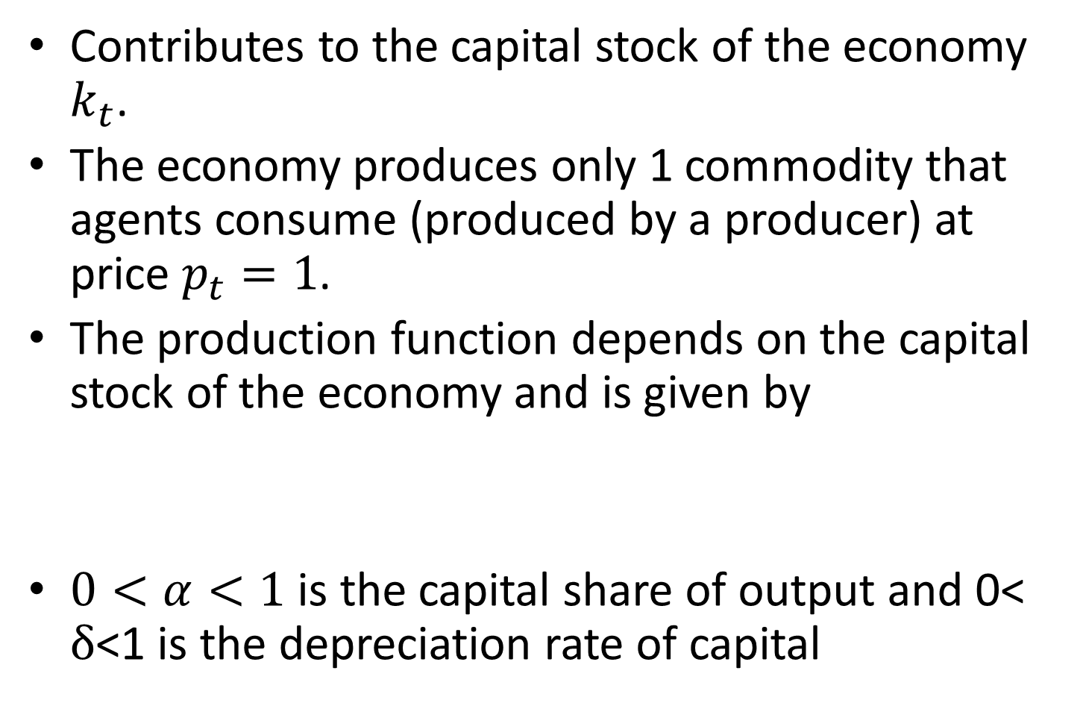

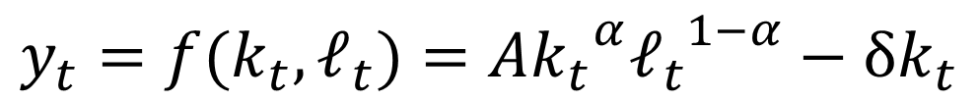
Where do the savings $s_{t}$of young agents go?
Contributes to the capital stock of the economy $k_{t}$.
The economy produces only 1 commodity that agents consume (produced by a producer) at price $p_{t}=1$.
The production function depends on the capital stock of the economy and is given by
$0<α<1$is the capital share of output and 0< $δ$<1 is the depreciation rate of capital
$$y_{t}=f(k_{t},ℓ_{t})=A{k_{t}}^{α}{ℓ_{t}}^{1−α}−{δk}_{t}$$

Slide 27
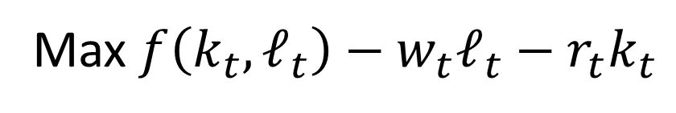

Producers maximize their profits for given prices $w_{t}$and $r_{t}$
Max$f\left(k_{t},ℓ_{t}\right)−w_{t}ℓ_{t}−r_{t}k_{t}$

Slide 28
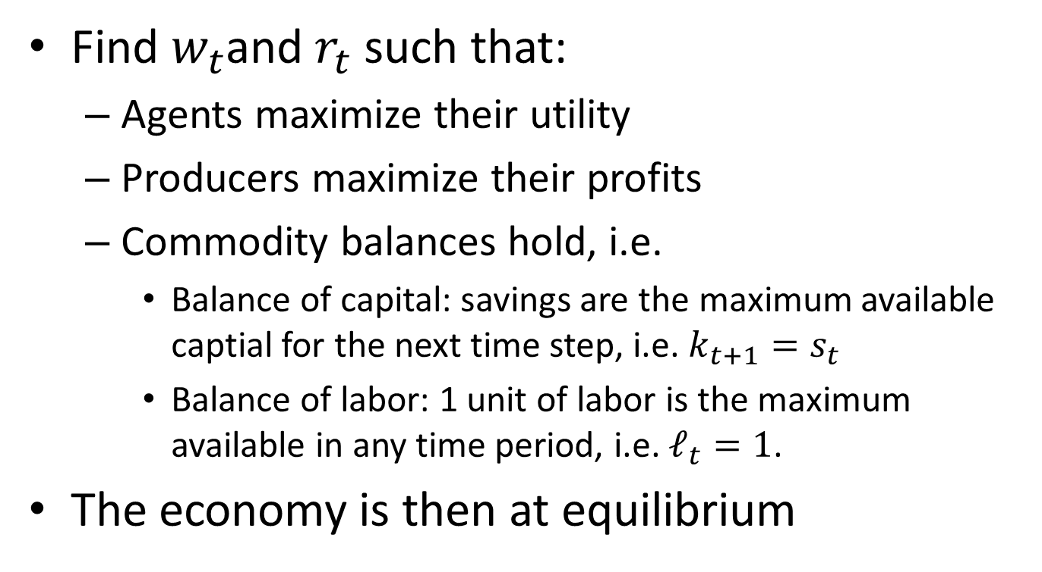

Still need to find prices $w_{t}$and $r_{t}$ to solve for the coevolution of environment quality & economic growth
Find $w_{t}$and $r_{t}$ such that:
Agents maximize their utility
Producers maximize their profits
Commodity balances hold, i.e.
Balance of capital: savings are the maximum available captial for the next time step, i.e. $k_{t+1}=s_{t}$
Balance of labor: 1 unit of labor is the maximum available in any time period, i.e. $ℓ_{t}=1$.
The economy is then at equilibrium

Slide 29


Equilibrium prices
$$w_{t}=(1−δ)f(k_{t},1)$$
$$r_{t}=\frac{∂f(k_{t},1) }{∂k_{t}}−δ$$

Slide 30
End of hour 3

Slide 31

Dynamics of environment quality and economic growth
Solve the utility maximization problem of agents for $c_{t}$ and through substitutions one obtains the evolution equations of
environment quality (as a function of$E_{t−1},E_{t−2}$and$k_{t−1}$)
capital (as a function of $E_{t},E_{t−1}$)

Slide 32

Coupled difference equations of environment quality and economic growth
Environment quality
$$E_{t}={(1+1/η)}^{−1}\left[\left(1−b\right)E_{t−1}−\frac{\left(β−γτ\right)\left(1+r_{t−1}\right)}{ηγ\left(1+τ\right)}\left(E_{t−1}−φE_{t−2}\right)+γ(w_{t−1}+\frac{φE_{t−1}}{ηγ})\right]$$
Economic growth
$$k_{t}=\frac{\left(E_{t}−φE_{t−1}\right)}{ηγ}$$

Slide 33





Steady state functions of environment quality ($\overline{E}$) and capital ($\overline{k}$)
Let $E_{t}=E_{t−1}=\overline{E}$and${ k}_{t}=k_{t−1}=\overline{k}$
Environment quality:
$$\overline{E}=\frac{γ\overline{w}\left(\frac{η+1}{η}\right)}{B}=φ(\overline{k})$$
where
$$B=1−\left(\frac{η+1}{η}\right)\left[\left(1−b\right)−\frac{\left(β−γτ\right)\left(1+\overline{r}\right)}{ηγ\left(1+τ\right)}\left(1−φ\right)+\frac{φ}{η})\right]$$
$\overline{w}$=$(1−δ)f(\overline{k},1)$, $\overline{r}$=$\frac{∂f(\overline{k},1) }{∂k_{t}}−δ$
Economic growth:
$\overline{k}=\frac{\left(1−φ\right)}{ηγ}\overline{E}⟹\overline{E}=φ(\overline{k}$)

Slide 34




Steady state evolution equations
$$φ(k)$$
$$E$$
$$φ(k)$$
$$k$$

Slide 35

Some examples: Environmentally conscious society that is heavily habituated to environment quality
Parameters:
$η$ = 0.5; %preference for environmental quality
$φ$ = 0.9; %degree of habit formation of environmental quality
b = 0.2; %Environment'self rate of degradation
$γ$ = 0.5; %Environmental maintainance efficiency
$τ$ = 0.1; %tax rate to conserve environment per unit consumption
$δ$ = 0.025; %capital rate of depreciation
$β$ = 0.1; %degree of environmental quality caused by a unit of consumption
$α$ = 0.1; %capital share of output
A = 1; %total factor of productivity
Initial conditions: $E_{0}=0.5, k_{0}=0.5$ (medium initial quality & capital)

Slide 36
Steady state evolution equations
$$φ(k)$$
$$E$$
$$φ(k)$$
$$k$$

Slide 37



Nonlinear dynamics of E and k from some initial conditions$(E_{0},k_{0})$: “Co-evolution”
$$E$$
$$(E_{0},k_{0})$$
$$k$$

Slide 38
Dynamics of Environment quality with time

Slide 39
Dynamics of capital with time (Economic growth)

Slide 40

How taxation affects the dynamics (co-evolution) of quality and growth
$E_{0}=0.2, k_{0}=0.01$(low initial environment quality and a poor society)
All other parameters remain the same except tax rate $τ$, i.e. the society is environmentally conscious and forms habit for good environment quality over time
Consider $τ=0, 0.05 and 0.10$.
Optimal tax policy?

Slide 41

Coevolution under different tax regimes for moderately rich society with high initial environment quality
Environmentally conscious and strong tendency for habit formation for environment quality
$E_{0}=1, k_{0}=0.5$
Are such societies doomed?

Slide 42
How about societies with no habit formation for environment quality
Plug and play

Slide 43
End of hour 4

